Slide 1
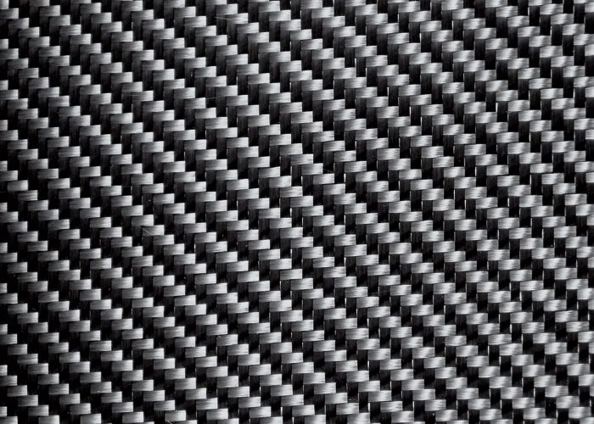
The Composites Group (Pty) Ltd
Enabling advanced manufacturing value creation though composites in South Africa
Consult / Think
Composites technology
Techno-economic studies
Value chain analysis
Scenario analysis
Expert Opinion
Consult
Composites technology
Natural fibre & Biocomposite specialisation
Value chain analysis
Feasibility reporting
Scenario analysis
Expert Opinion
Property / Build
Composites Factories
Regional cluster & Hub development
SMME development
Management Services
Project management
Factory management
Technology upscaling
Value chain upscaling
Business creation
Contact: andy@thecompositesgroup.co.za
+27 (0) 72 375 3671

